Slide 1
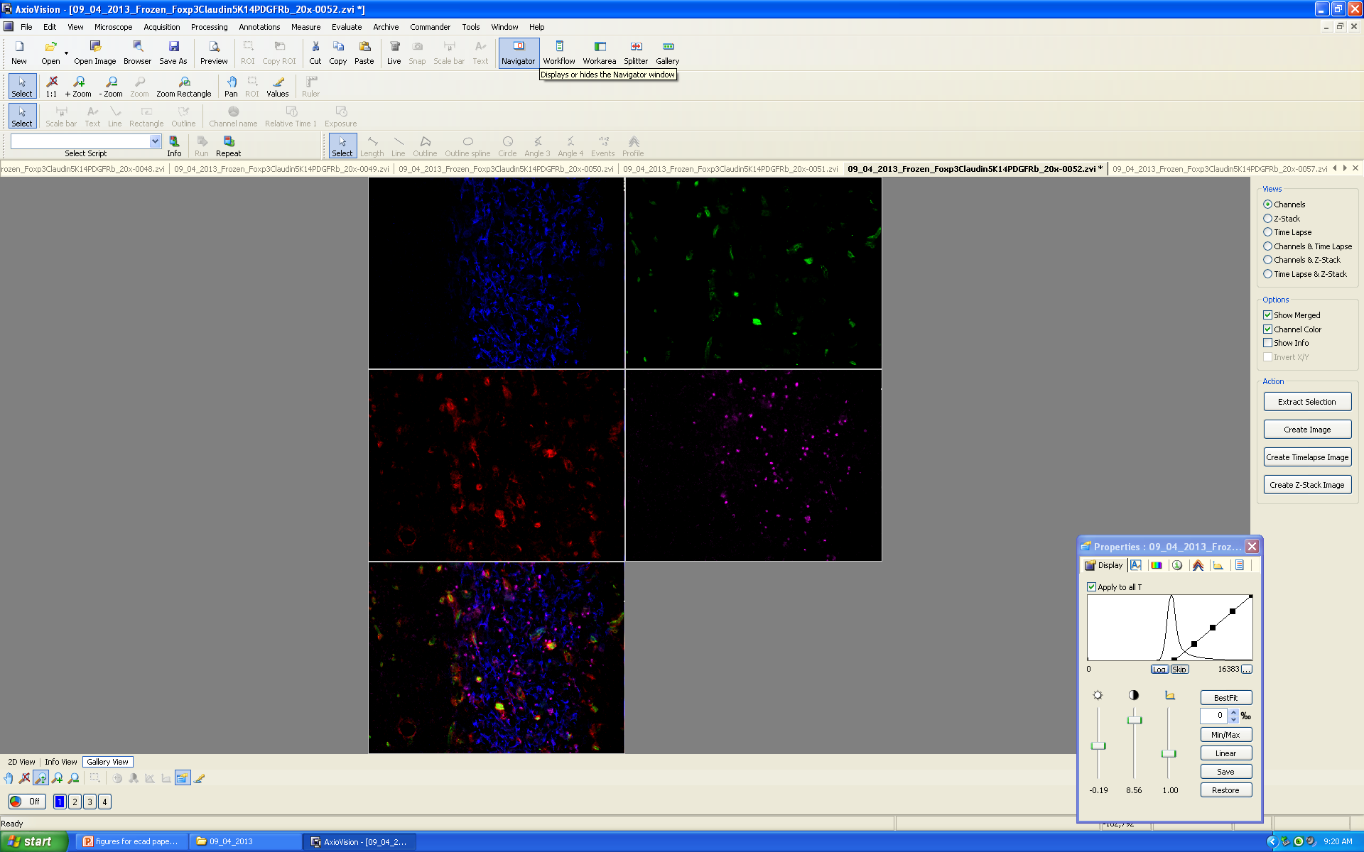
K14-Blue Claudin5-Green PDGFRb-Red Foxp3-Purple 20x Lab Microscope Frozen Antibody Set 1
Cellular Ecology of the Mouse Thymus
Mary Browning
3/17/2015
Mary Browning
3/17/2015
Notes:
Project ive been working during my time here as a graduate student
When I first started working on it, it was just a cool idea my advisors had
Didn’t know if if would even work
Today im showing the progress we have made

Slide 2
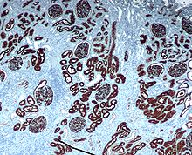
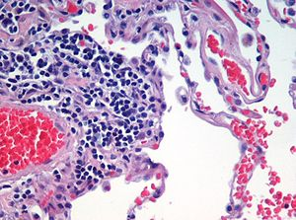
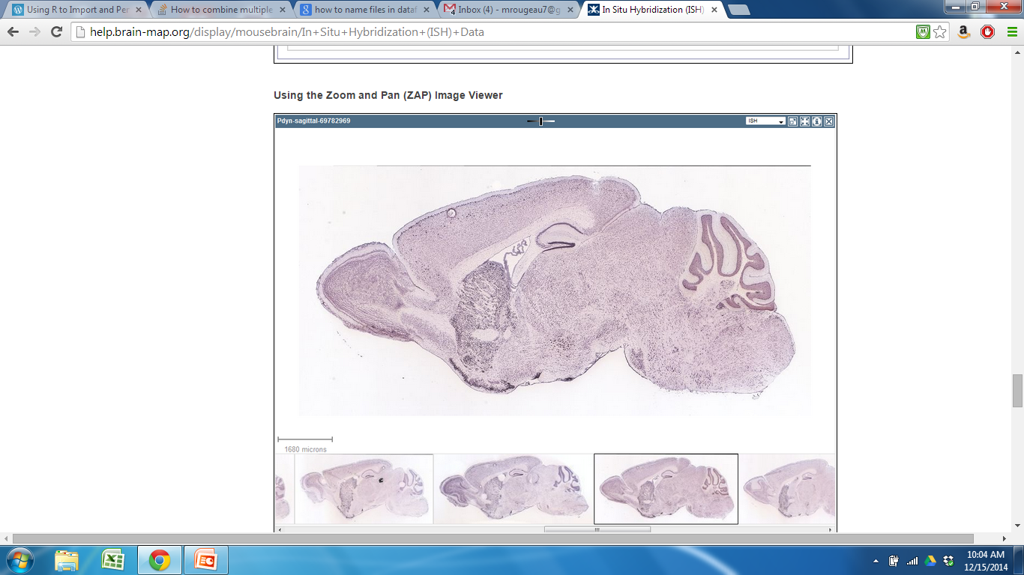
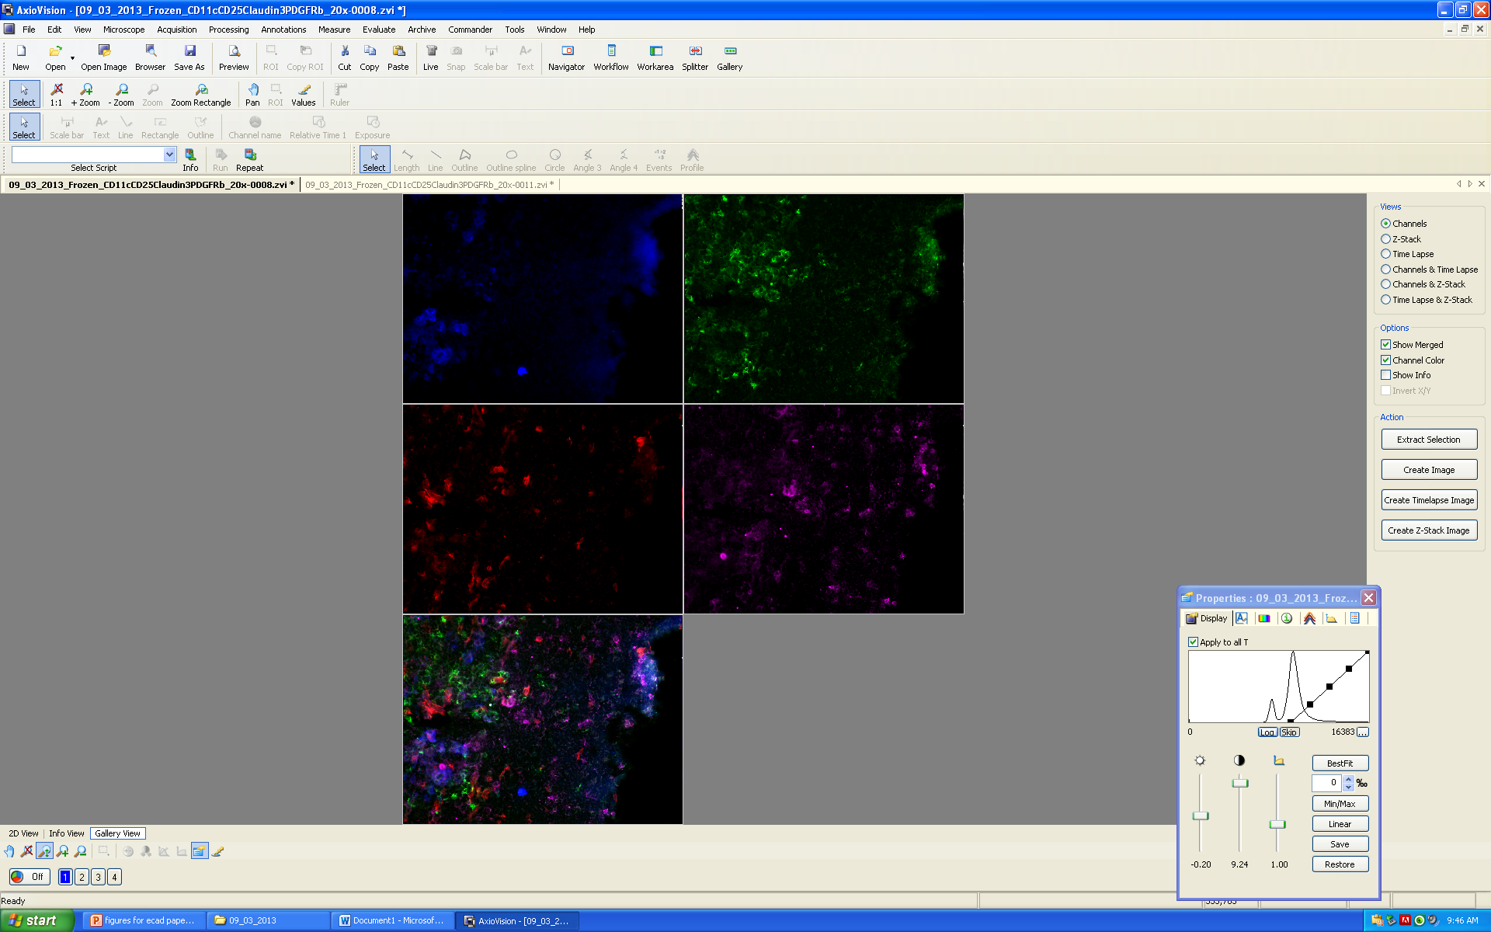
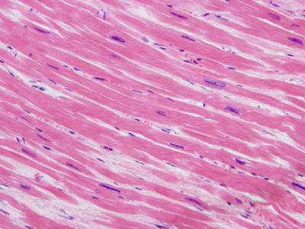
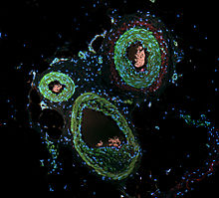
Organization of Organs
Human Kidney; IHC
Human Lung Tissue; H&E
Mouse Brain; In Situ
Mouse Thymus; Immunofluorescence
Heart muscle; H&E
Actin in smooth muscle of skin; Immunofluorescence
Notes:
Overall goal of my project was to CREATE A METHOD to QUANTITATIVELY EVALUATE organization of cell types in of biological organs.
Currently for looking at organization, we rely upon DESCRIPTIVE ASSAYS, have had SUCCESS; ____CLICK (for instance, in this example☺
BY USING DESCRIPTIVE METHODS we have been able to look at tissues and organs in greater detail;
From this point on: Thymus: our organ
Problem with DESCRIPTIVE METHODS; limited by what you are able to see,

Slide 3
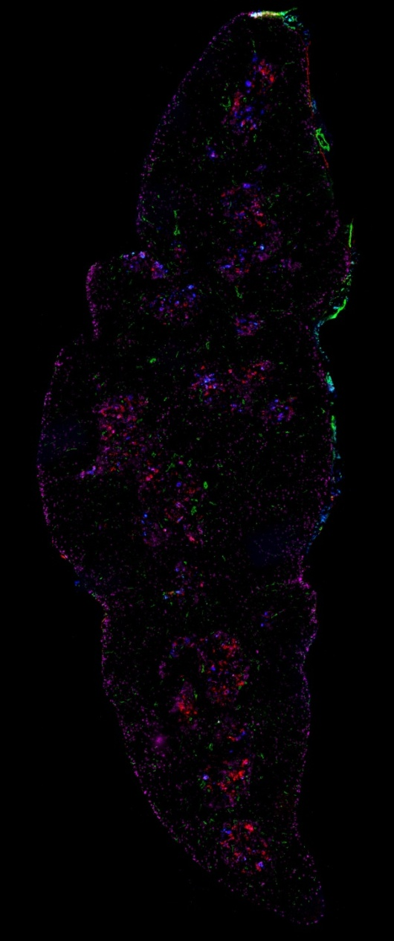
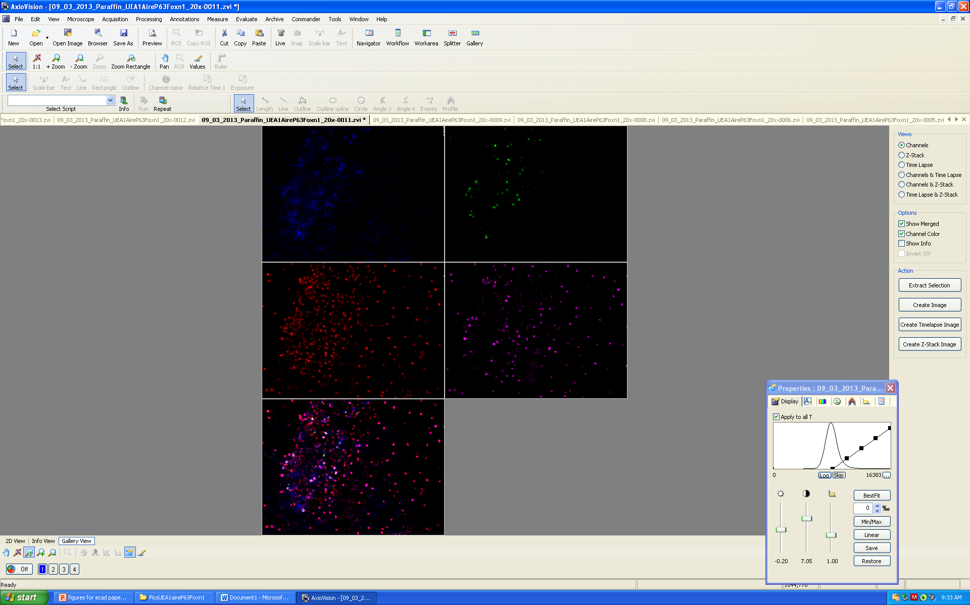
Cell Types in the Thymus
P63
P63, UEA1, Claud34, CD31
Notes:
FOR INSTANCE, if you look at one cell type, can get a pretty good idea of what is going on (idea about abundance and location, make comparisons with mutant/diseased tissues to see if different)
But what about if you look at multiple cell types; hard to detect patterns or relationships bt cells
multiple cell types covering a large area
DIFFICULT develop a COMPLETE PICTURE of what is going on, especially if want to look at LOTS OF INFO at once (cell types covering a large area)
Wanted to develop a COMPUTATIONAL method for looking at organization to ELIMINATE these LIMITATIONS;
A computer can identify and keep track of all these cell types and calculate different statistics
enable us to look at organization in GREATER DETAIL
hopefully allow us to develop a BETTER UNDERSTANDING of organ FUNCTION as a whole

Slide 4
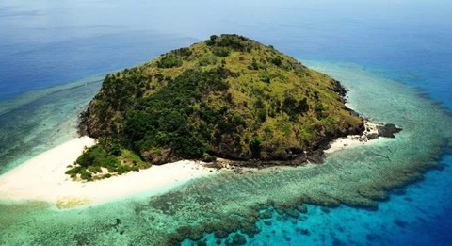
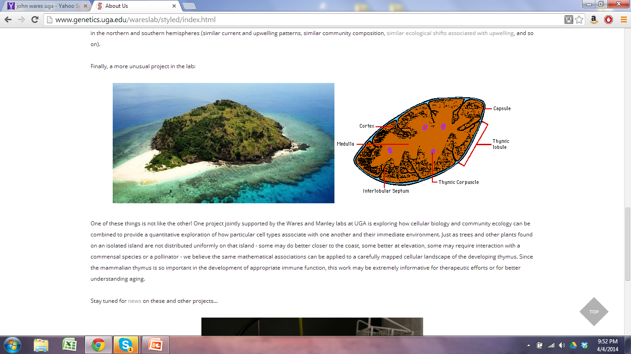
How can we quantitatively evaluate organization of cell types in organs?
Notes:
We came up with idea to treat organ like an ecosystem, can apply quantitative approaches used in ecology directly to a biological organ
For this project, compare thymus to island:
DIFFERENT REGIONS (island has sandy area where land that meets water, area dense with with trees, river or lake somewhre
Within regions of island; different COMPOSITIONS and ABUNDANCES of SPECIES that have different ROLES and distributions
thymus: REGIONS that are IDENTIFIED by CELL TYPES present
cells have different roles and distributions
By making this comparison and treating thymus like an ecosystem/ecological community, we can directly apply quantitative approaches used in ecology to thymus

Slide 5
Ecosystem | Organ-Thymus
Do species aggregate or is distribution random? | Beyond regional organization, are cells in the thymus organized a certain way?
How is diversity distributed across the community? | Are patterns of organization consistent throughout the thymus? Between individuals? Random?
How does removal or addition of a species affect organization? | How does a wild-type organ differ from a mutant? Diseased organ?
Are there keystone species? | How does removal of a cell type affect organization?
Notes:
Several questions we were interested in asking about the thymus (listed on right)
On left are the parallel questions asked by ecologists for centuries about communities
Have developed methods to answer these questions
SLIDE
Some respects, easier to look at organ.
Removal of species takes long time (months to years), create gene knockouts in mouse to remove specific cell types
Completely rearrange cellular environment? Will it have a detectable effect?

Slide 6
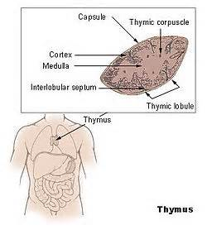

Background
Why is the thymus important?
Essential for proper immune system function
Programs T cells
Loss of functional thymic activity = reduced functional T cell output
Susceptibility to diseases
Autoimmunity
Notes:
SLIDE
Takes immature t cells and turns them into functional mature t cells (involved in immune response)
-involved in immune response
Besides the fact that the thymus is clinically important. There are several reasons Thymus is great organ for this type of analysis/comparison.
was chosen because size (easier to perform analysis) and because of structure
Also, have TOOLS available that can be used for analysis
Have cellular markers for different cell types and different t-cell differentiation stages/ Markers combined cover a good portion of the thymus
Through descriptive analysis (using cell specific markers), we know general patterns of regional organization
We don’t even know specifics about cellular level organization,
very interested in understanding; give us insight into organ function
```````````````````````````
Organs that would be especially useful for include:
endodermal glandular organs (thymus, liver, pancreas) , no discernable features
structure is more difficult to perceive (as opposed to organ like heart: cut open and see compartments and vessels)
organizational structures that are visible only with the use of molecular or cellular markers

Slide 7
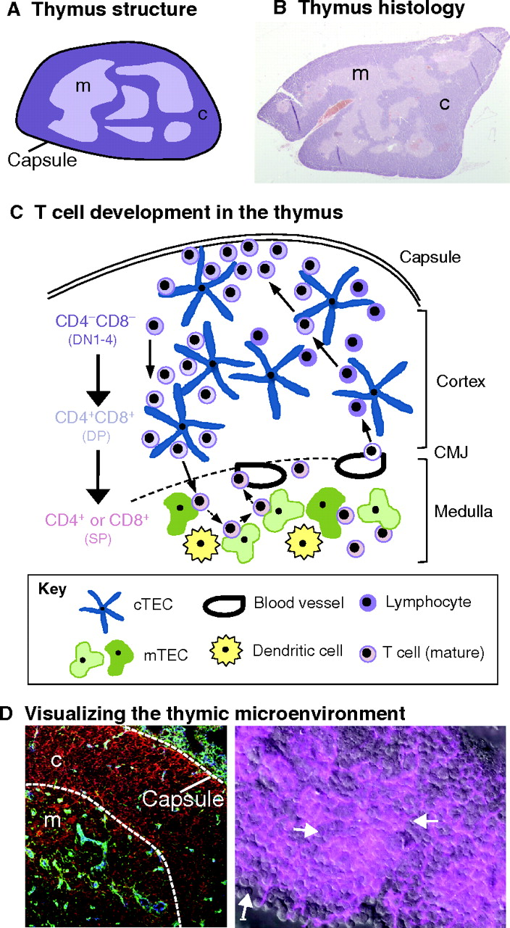
Thymus Cell Types and Migratory Pathway of T cells (Adult WT Thymus)
Notes:
General info –zoom in on a portion of the thymus; get image that looks like this
Picture is showing section of thymus from the capsule downward to medulla
REGIONS
Several different regions
Cortex: Outer region (more t cells, stromal environment is less dense)
Medulla: Inner region
Cortocomedullary Junction (CMJ): Area where they meet
Subcapsular region: Outer cortex
CELL TYPES- within these regions are different compositions of cell types
Resident cell types:-make up the organ-stromal-plants in environment
Thymic epithelial cells (TECs)-support mTECs (medullary thymic epithelial cells)-cTEC (cortical thymic epithelial cells)
Vasculature-blood vessels (t cells and nutrients)
Dendritic cells-maturation of t cells
Migrating cell types: animals in environment
T cells
KEY POINT: interactions with microenvironments crucial for development, don’t know much about organization

Slide 8
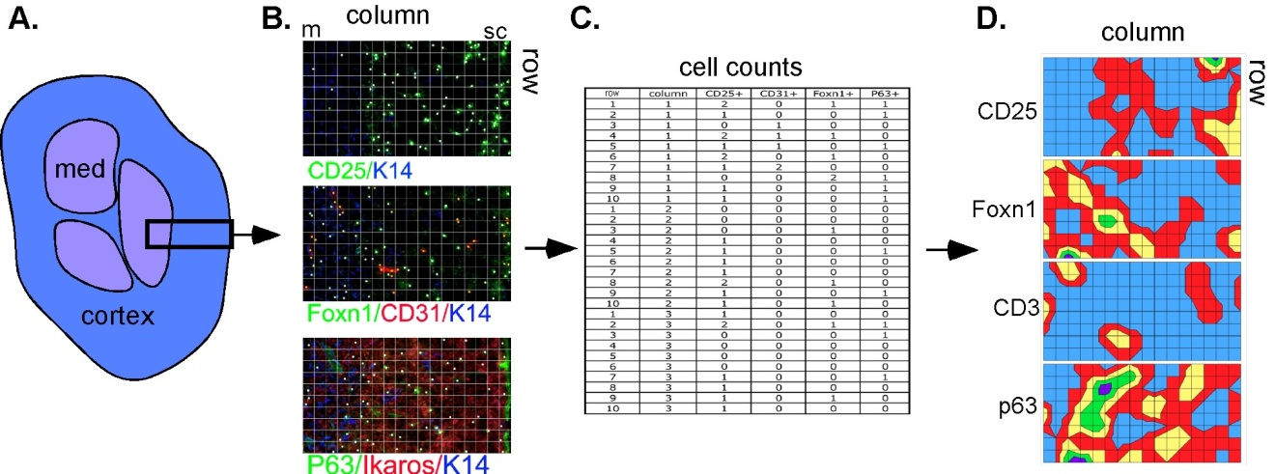
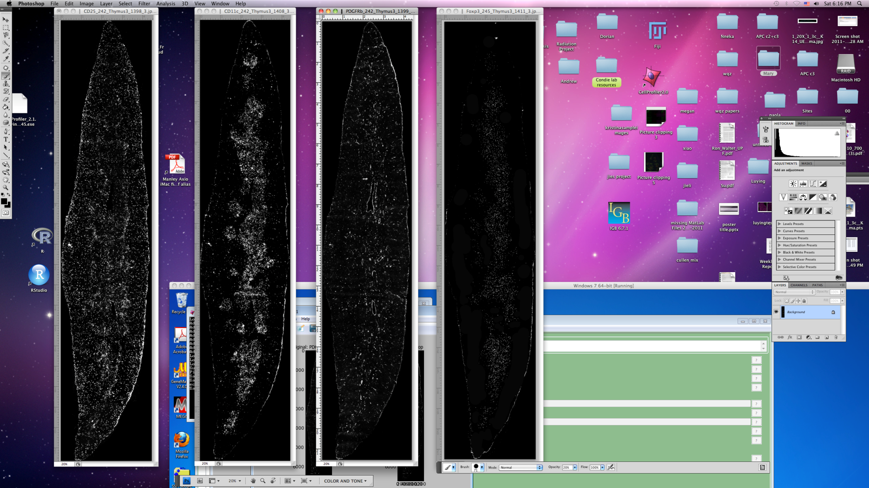
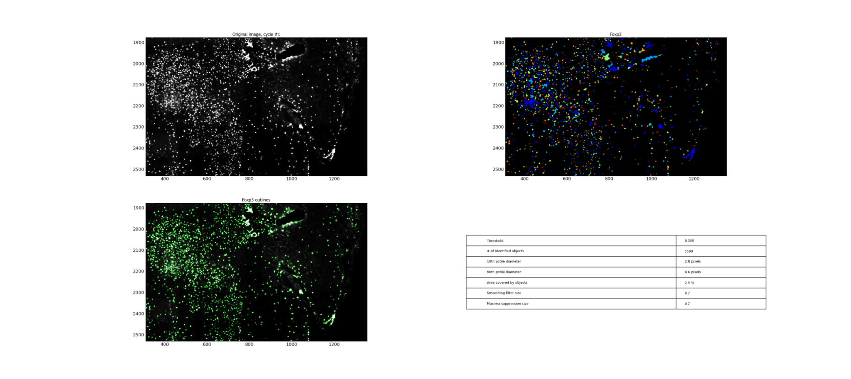
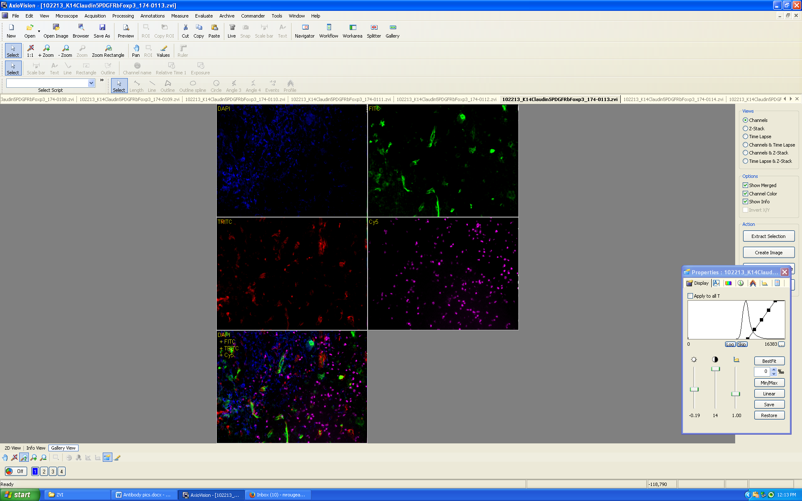

Overview of Methods-Identifying and analyzing cell types
Step 1 Step 2 Step 3 Step 4
Cut sections and
stain with antibodies
Take pictures
with microscope
Recreate section and perform
cell counts in CellProfiler
Perform spatial
analysis
Notes:
GOAL:IDENTIFY MANY CELL TYPES (increased statistical power for analysis)
Take middle sagittal sections of 1 month old wild type left lobe thymus and stain them with antibodies that bind to specific cell types
Take pictures with microscope along the entire thymus section
Piece them together using PTGui (panaromic pic stitching software) and use Cell Profiler (cell counting program) to perform cell counts on sections
Use cell location and abundance info from these sections for spatial analysis, this image is showing a heat map of different cell markers
Example of 4 cell types on microscope
Limited by # of channels and antibodies available
Blood vessels,
Subsets of mTEC and cTEC
Subsets of T cells
Dendritic cells

Slide 9
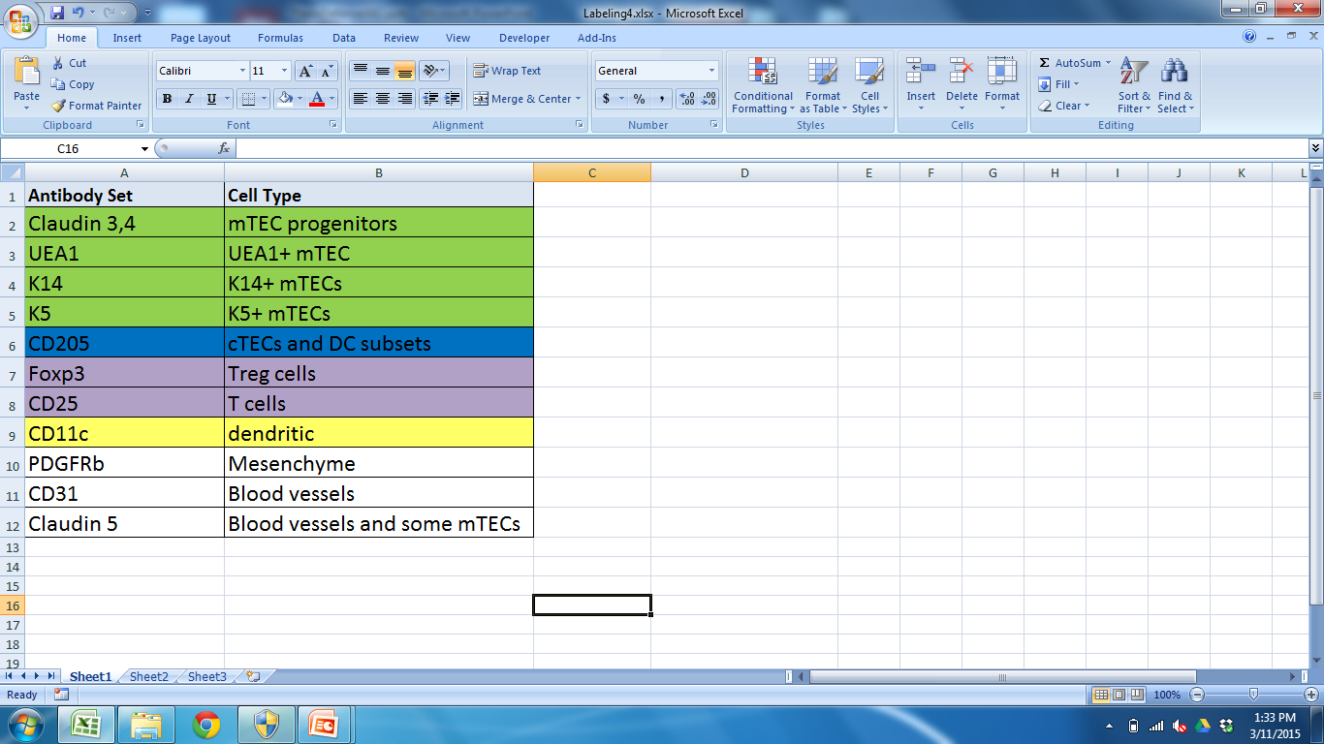
Cell markers included in analysis
Notes:
Tried to correspond to the colors in the image
More markers for mTEC
More diversity in medulla; different subsets of mTECs that we have markers for that work well
Don’t have as many markers as cortex

Slide 10
Goal: Develop a quantitative model to characterize the organization of cell types in a mouse thymus.
Spatial and compositional clustering (K means)
Notes:
SLIDE
Before we can characterize;
First Determine if organizational patterns similar throughout individual thymus and bt WT thymii samples of same genotype and age
If they are-develop a general model to characterize this organization that can use for comparisons
Determine this through the use of K means clustering

Slide 11
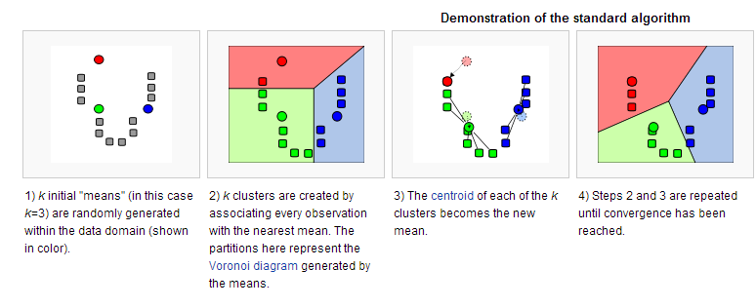
K means Clustering
http://en.wikipedia.org/wiki/K-means_clustering
Notes:
K-means clustering is a data mining technique that uses an algorithm to cluster observations with observations they are most similar to
The algorithm clusters observations into k groups, where k is provided as an input parameter.
GENERAL overview of how Kmeans works
GO OVER IMAGE
Minimize difference within a cluster and maximize difference between
WE CHOSE TO USE K MEANS AS OPPOSED TO OTHER CLUSTERING METHODS BECAUSE:
CAN CHOOSE DIFFERENT CLUSTER VALUES, identify cryptic info (manipulate K)

Slide 12

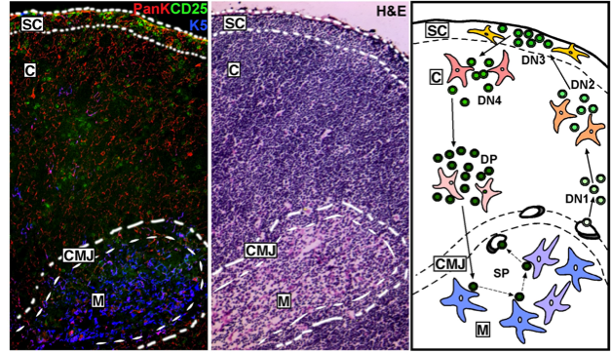
K means clustering
Regions
Cortex, Medulla, Subcapsular region, CMJ
Can these regions be computationally reproduced?
Do we identify cryptic information (other regions or subregions?
Is pattern consistent throughout thymus? Between samples?
Notes:
Apply K means clustering to our dataset that contains cell type, abundance, and location
REASON TO USE: K means will do this by detecting GEOGRAPHICAL regions of COMPOSITIONAL similarity
Compare to previously identified regions; determine if patterns similar within and between
SLIDE

Slide 13
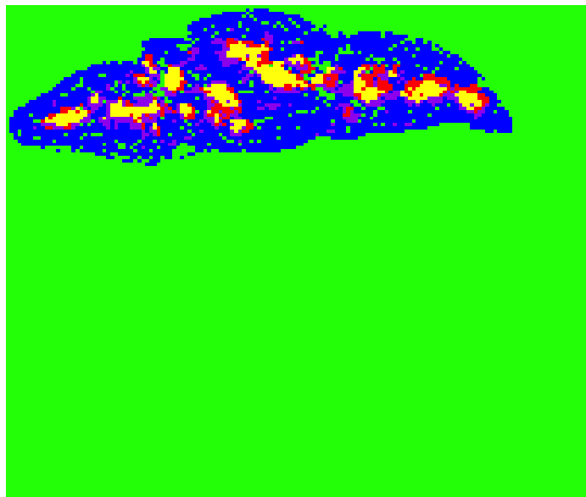
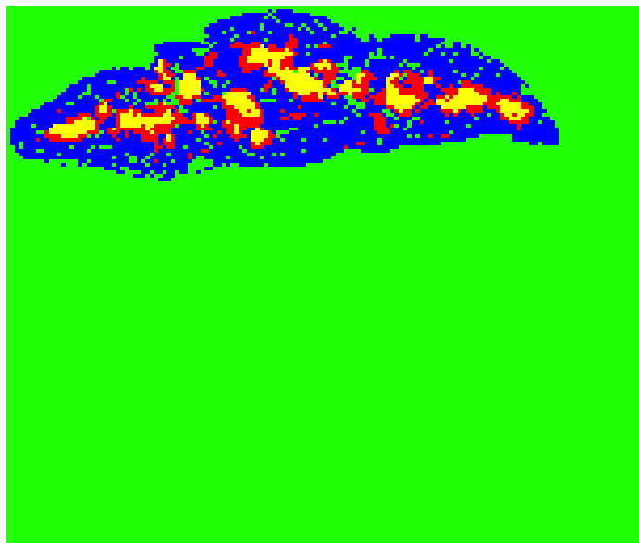
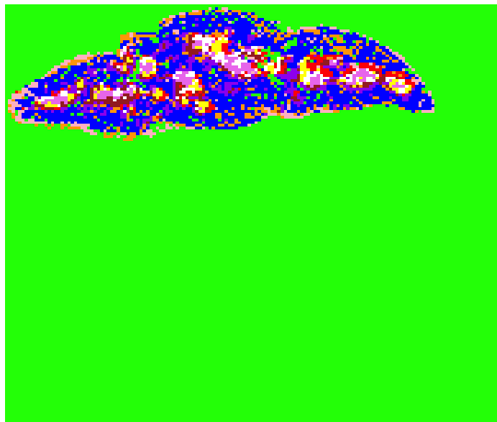
Clustering Results K=4 K=5 K=10
Notes:
RESULTS showing where clusters formed on individual thymus section (we have multiple sections); compared to real sections stained with antibodies
Describe K and colors
Initially started with K=3, medulla and cortex; expected bc we have antibodies for these regions
However, Don’t have antibodies specific for CMJ or Subcap? If increase k, can we reproduce? Identify new info?
K=4 Subdivision of medulla, CMJ? K=5, more clustering in medulla, Increase more-clusters everywhere
Proceed with develop methods, go back; Interested in medullary clusters in K=4,

Slide 14
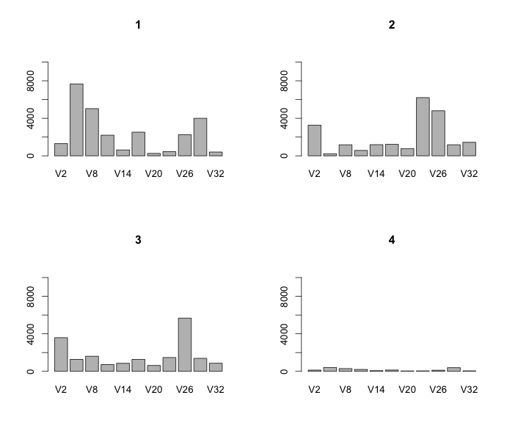
How is clustering being done?
Green
Blue
Red
Yellow
Number of Cells
Cell markers
Cell markers
Number of Cells
Cell markers
Number of Cells
Cell markers
Number of Cells
Cell markers
Notes:
Next step: Figure out how clustering is being done? What info is in each cluster
Produced graphs showing the AMOUNT OF CELL TYPE PER CLUSTER.
General idea of what cell types are driving this clustering
Blue-ABUNDANCE of SEVERAL CELL TYPES throughout this cluster-cell types correspond to the cortex
Draw attention to red and yellow clusters-area corresponds to medulla; there are compositional differences bt the two
patterns similar but can detect subtle differences,
red and yellow share high abundance of 1 cell type; yellow: see presence of cell type you don’t see in red
by looking at section stained with cell types, cant distinguish different compositions in medullary region,
Development of quant. Method VALUABLE bc by looking at a tissue section stained with antibodies, you don’t see this level of organization

Slide 15
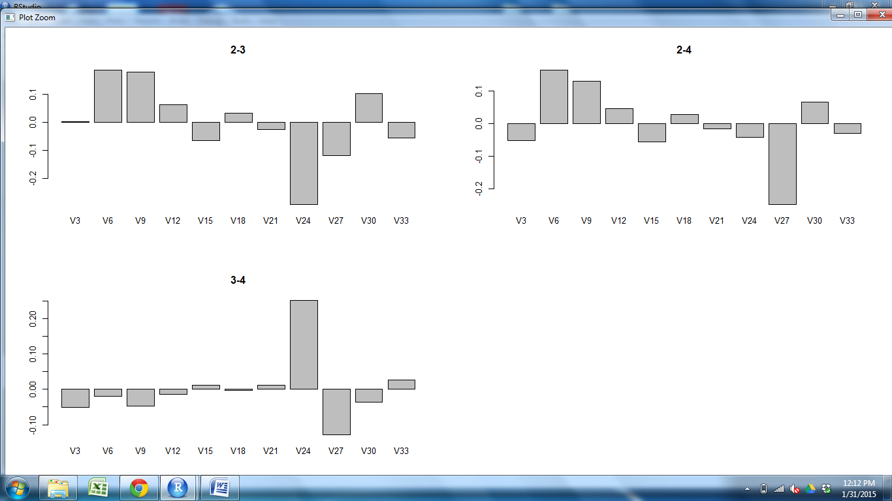
Comparing Clusters
Yellow vs Red
Cell abundance
CD205
CD25
Claud34
Claud5
Foxp3
K14
K5
PDGFRb
UEA1
CD11c
CD31
Cell markers
Notes:
Comparison of CELL TYPES BETWEEN CLUSTERS
to see if certain cell types are more common in certain clusters
SLIDE: One cell type more abundant yellow; other in red.
Interested in this pattern bc it could be either CMJ or 2 medullary regions

Slide 16
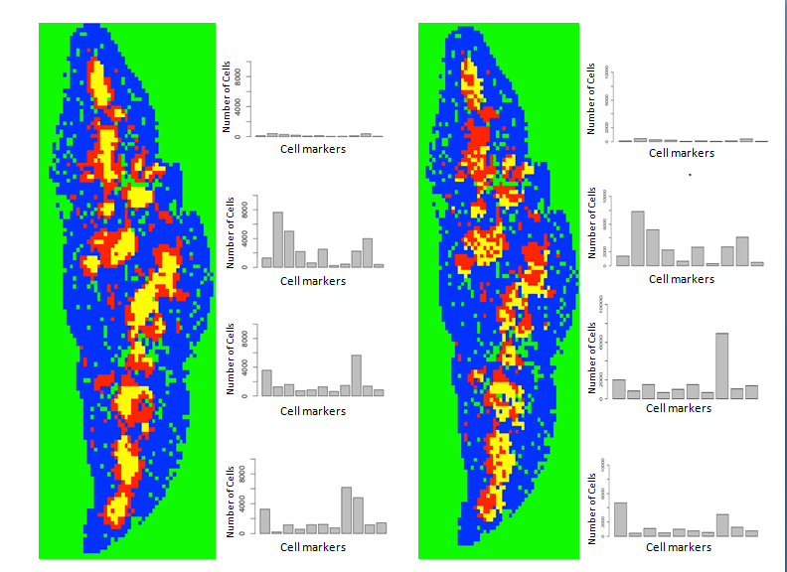
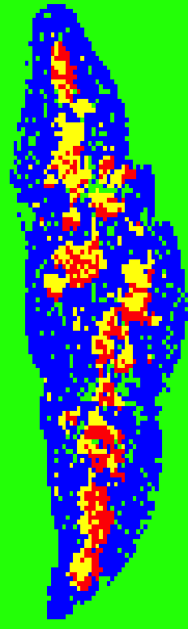
Remove cell types-K14
Notes:
Another capability of quantitative analysis: can remove cell types from dataset and see how clustering is affected
K14 removal-More mixing bt clusters
Valuable bc can Manipulate dataset, can focus on cell types (in any combination we want to!) also cell types that are less abundant

Slide 17
Goal: Develop a quantitative model to characterize the spatial organization of cell types in a mouse thymus.
Spatial and compositional clustering (K means)
Use an ecological index on different regions that are produced
Notes:
K Provides Useful compositional and geographical information, but Graphs descriptive
Begin to APPLY ECOLOGICAL methods to the thymus
In ecology, different INDICIES that you can use to COMPARE the IDENTITY and relative ABUNDANCE of species across communities
The Bray Curtis Dissimilarity Index in particular is a well characterized statistical method that looks at compositional dissimilarity between sites based on cell counts
0 = identical (same composition), 1=don’t share any species; typically multiplied by 100 and given as a percent
Use this index to determine how similar clusters produced from K means
make comparisons with sections in same thymus and between thymuses

Slide 18
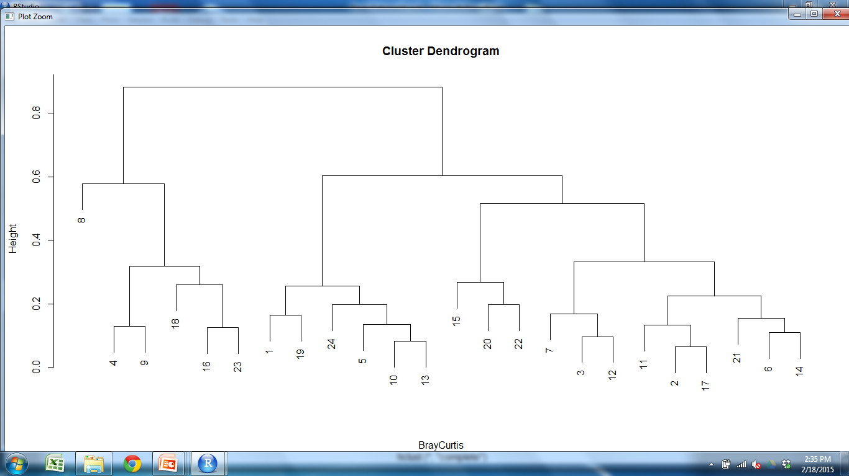
Bray Curtis Dendrogram
OUTER CORTEX MEDULLA1 MEDULLA2
Key
WT1=
WT2=
M2S3 M2
Conclusion
Consistent grouping of clusters which correspond to same region
WT samples are compositionally similar to other WT samples
Notes:
BC produced results from 0-1; Produced dendrogram using BC results for easier visualization
In this example, we are looking at 2 WT samples; 3 sections from each sample (24 clusters)
several groups form;
Saw fairly consistent grouping of clusters which corresponded to same region (cortex with cortex)
We did see something interesting with respect to grouping of medullary clusters; WT1 grouped more closely with WT2; at this point, need more data
Overall, Based on these results, it appears WT samples are compositionally similar with respect to other .

Slide 19
Goal: Develop a quantitative model to characterize the spatial organization of cell types in a mouse thymus.
Spatial and compositional clustering (K means)
Use an ecological index on different regions that are produced
Repeat with Mutant
Notes:
repeat methods with a mutant;
Can we detect any organizational differences bt WT and mutant?

Slide 20
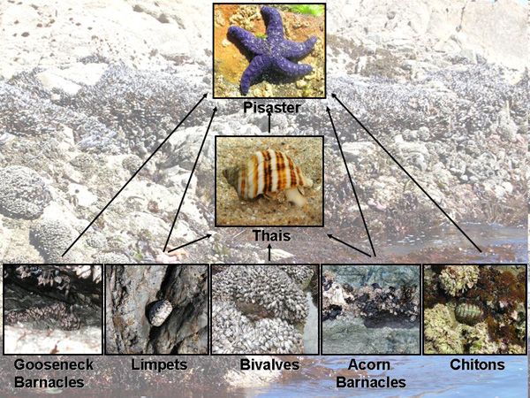
Removal of a “Species”
Keystone species
http://www.nature.com/scitable/knowledge/library/keystone-species-15786127
Notes:
We used a mutant knockout; Removed cell marker that identified a specific subpopulation of mTECs that we know to be FUNCTIONALLY important from previous studies that have been done
Detect Organization difference?
Can compare remove of cell type to removal of species in community; can expect several different results
EXAMPLE OF TYPICAL MARINE ECOLOGY COMMUNITY
Similar to Keystone species=removal completely alters organization and composition of community; wildly different-STARFISH
species are still there but there are changes in organization
still important but doesn’t produce any noticeable organizational effects

Slide 21
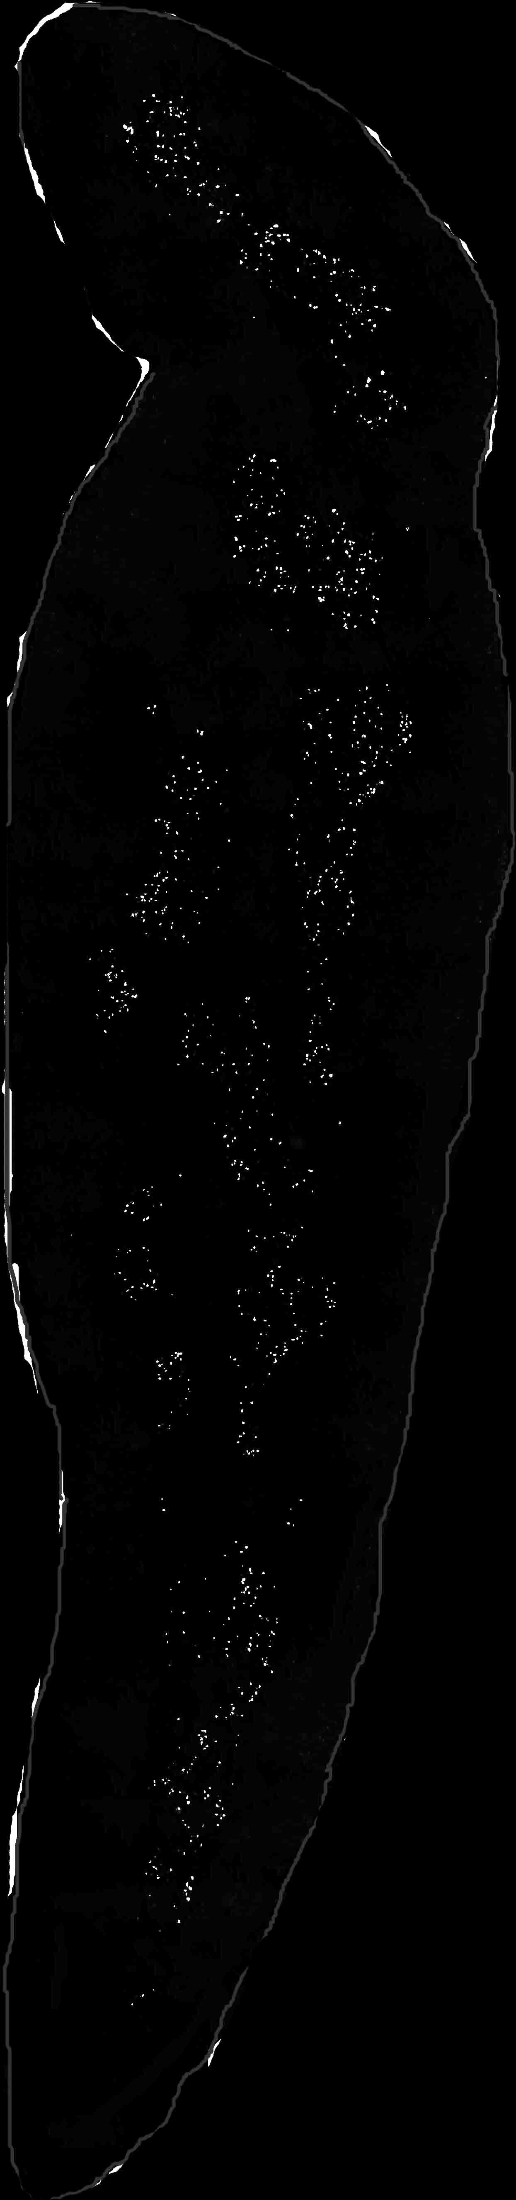
AIRE
Regulator of
tissue restricted
antigens in mTECs
Key modulator of
mTEC differentiation
APECED Autoimmune Syndrome in humans
REMOVAL OF AIRE
Doubling of
K14+ mTEC
Altered shape and
decreased abundance
of UEA1+ mTEC
Reduced number
of T-regulatory cells
Reduced dendritic cells
in medulla; increased
density at CMJ
K14 UEA1 CD11c Foxp3
Notes:
Removed Aire gene-
Aire has 2 roles in thymus-is a TF that REGULATES EXPRESSION OF TISSUE RESTRICTED ANTIGENS on mTECs (impt for central tolerance of t cells)
Removal of aire results in FAILURE TO REMOVE AUTOREACTIVE T CELLS; results in autoimmunity
as a possible KEY MODULATOR of mTEC differentiation
Failure of mTECs to become fully mature
KNOW AIRE IS FUNCTIONALLY IMPORTANT
Mutated aire in humans causes APECED
Debate/controversy as to effect removal of aire has on the organization of the thymus

Slide 22
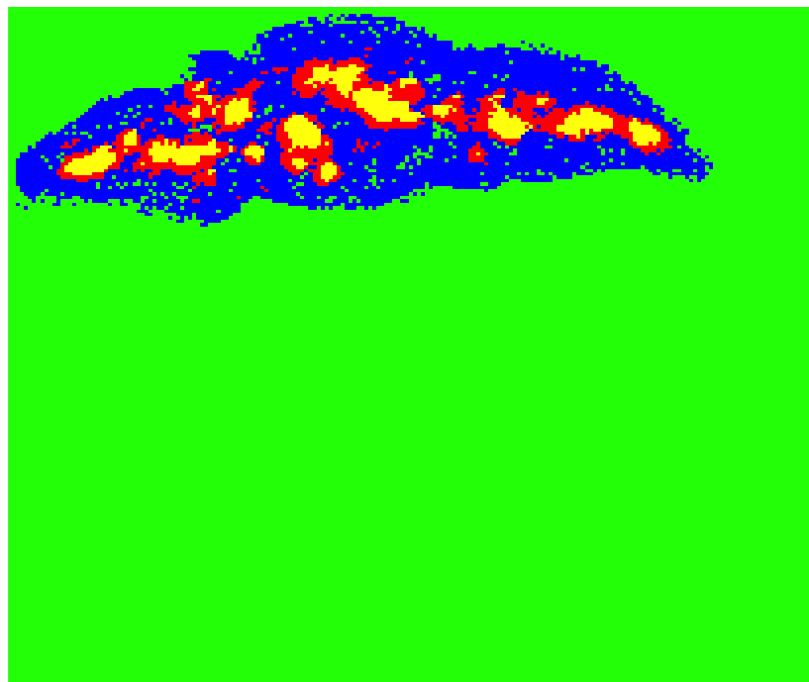
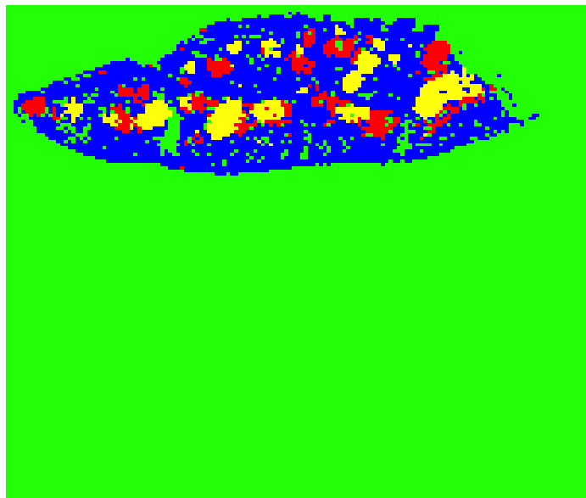
WT Mutant
Notes:
Repeated previous steps with a mutant; comparison of results of kmeans clustering with K=4

Slide 23
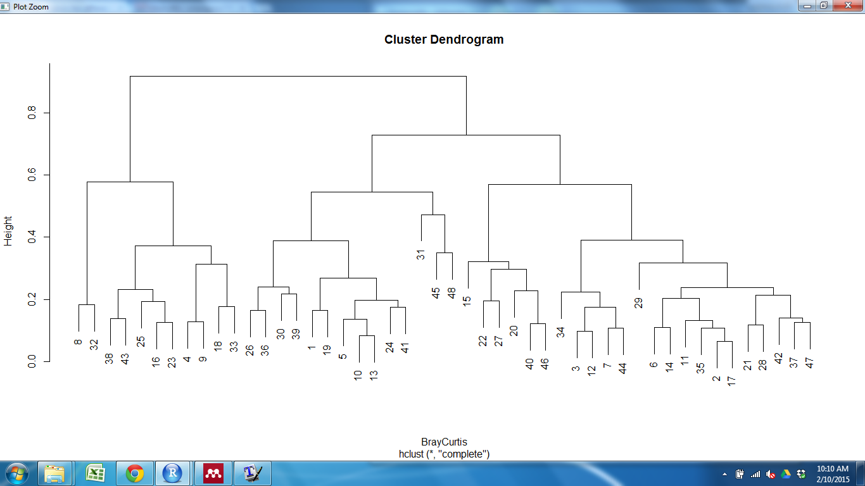
Bray Curtis Dissimilarity Index
OUTER CORTEX MEDULLA1 MEDULLA2
Key
WT1= Mutant1=
WT2= Mutant2=
Conclusion:
Consistent grouping of clusters that correspond to same region
Wild-type and mutant clusters are interspersed; not separated based on genotype
Samples are compositionally similar
Notes:
Repeated previous steps (clustering)
Again Produced dendrogram of Bray Curtis values
2 mutants and 2 wildtypes; 3 sections from each
BY looking at organization of groups: Grouping regionally again, WT and mutant INTERSPERSED, not separating based on WT and Mutant
Based on these results, samples are compositionally similar. What about spatially with respect to clusters?

Slide 24
Goal: Develop a quantitative model to characterize the spatial organization of cell types in a mouse thymus.
Spatial and compositional clustering (K means)
Repeat with mutant
Use an ecological index on different regions that are produced
Look at spatial relationships between clusters

Slide 25
Is organization of clusters different between WT and Mutant?
WT Mutant
Notes:
Red surrounds yellow in WT, adjacent in Mutant; organization of clusters appears to be different; quantify organization difference

Slide 26
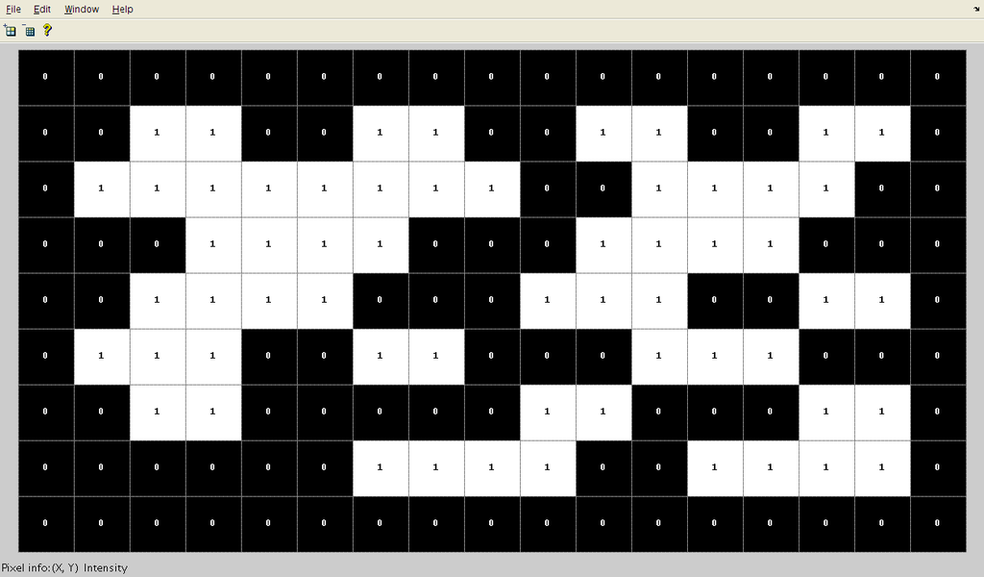
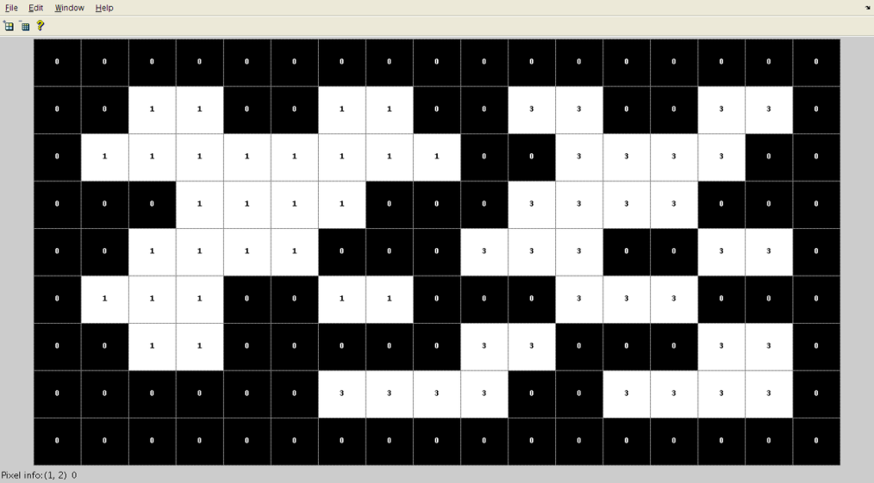
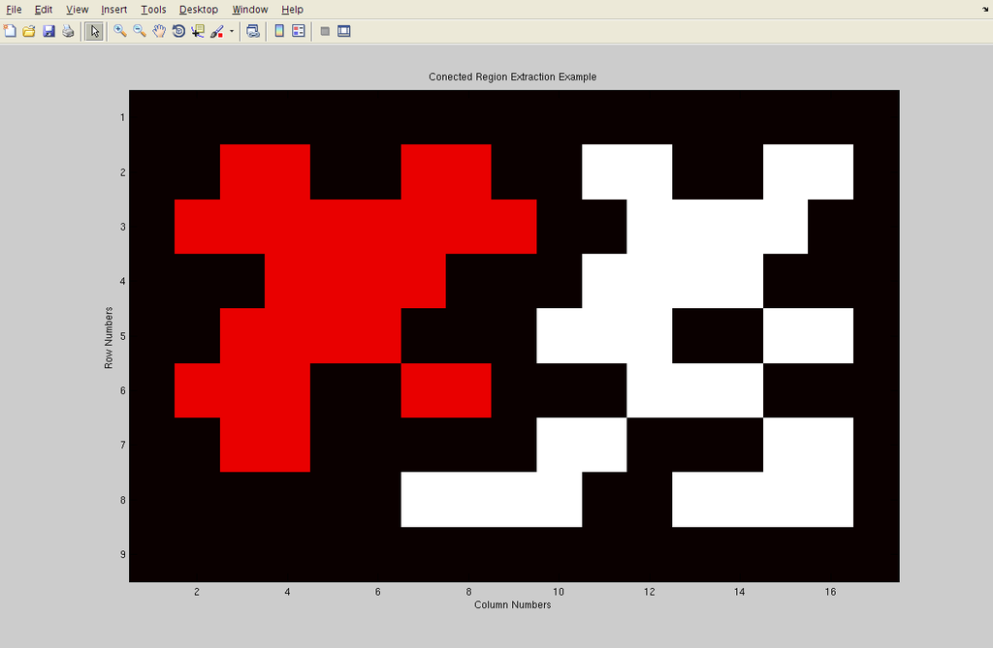
Connected Component Labeling (CCL)
NUMBER OF CLUSTERS
SIZE DISTRIBUTION
CENTER OF MASS (CENTROID)
DISTANCE BETWEEN CENTROIDS
http://en.wikipedia.org/wiki/Connected-component_labeling
Notes:
Works by identifying connected components and giving them a unique label
Matrix containing 0s and 1s
CCL SCANS MATRIX, groups components that are connected, and gives them a UNIQUE LABEL (number, color)
Perform different CALCULATIONS on these components

Slide 27
Is organization of clusters different between WT and Mutant?
WT Mutant
CCL Average (pixels)
WT Mutant
3.95 5.84
Notes:
Connected component labeling-technique Identify individual cluster components for each cluster;
Manually find centroid (center of mass) and find distance bt them
WT=centroid in center; small distance between: M2 is inset in M1
Mutant-adjacent, further distance between ; offset from
When we used CCL on our dataset; Values for WT were not what we expected them to be
the distance BT centroids for the WT was larger than we were expecting

Slide 28
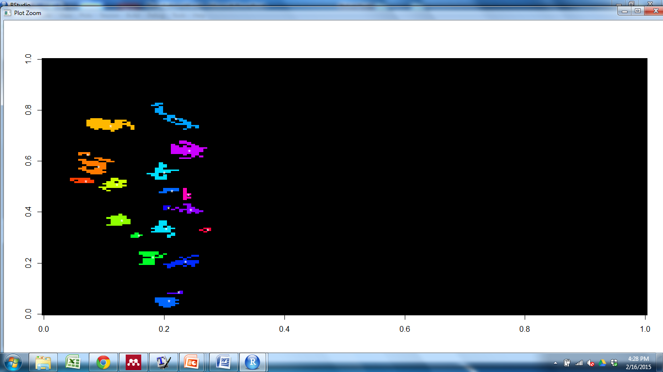
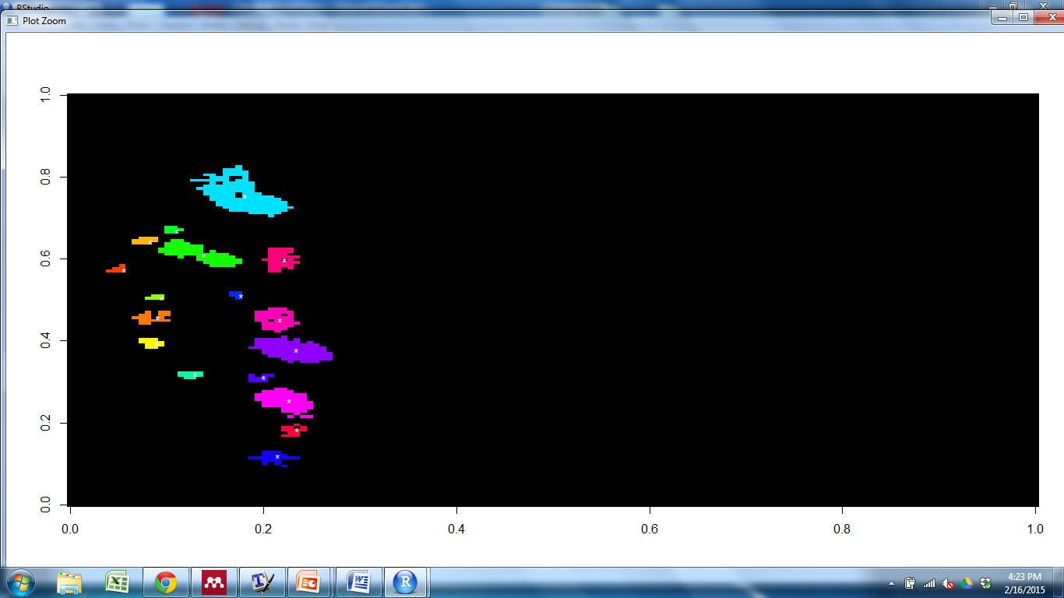
Connected Component Labeling-Mutant1
RED YELLOW
Notes:
Took a closer Look at results-Mutant looked good; identified clusters correctly

Slide 29
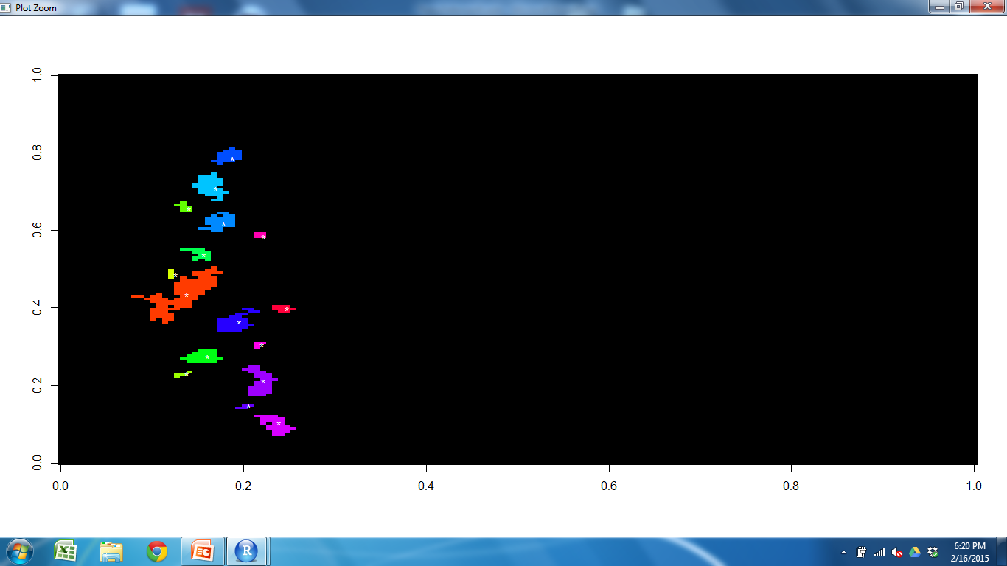
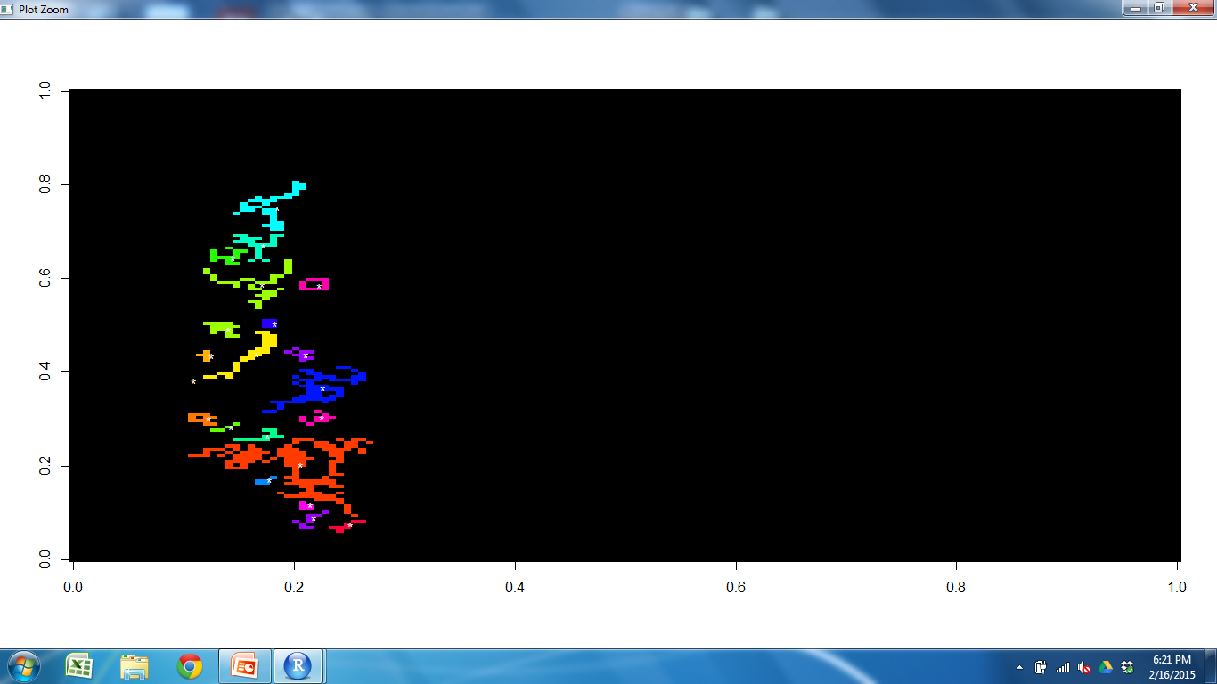
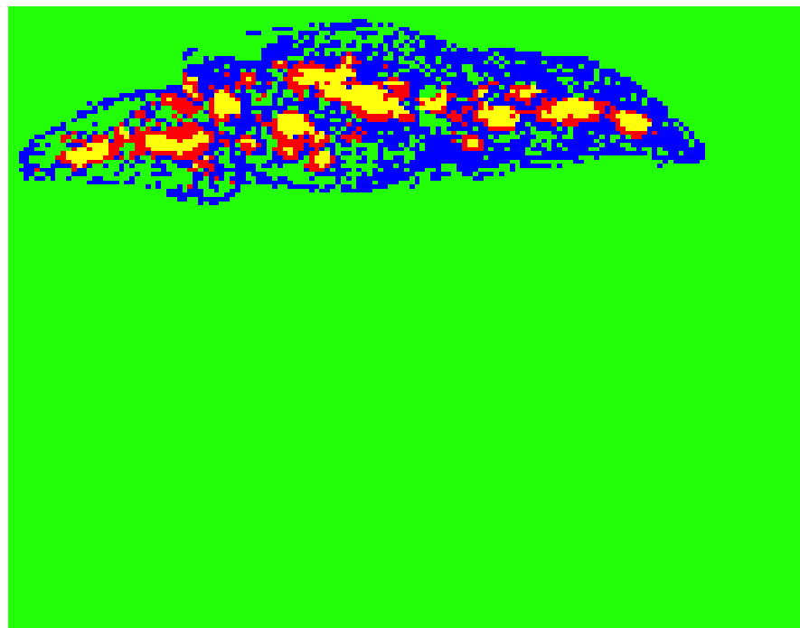
Connected Component Labeling Results
YELLOW BLUE
Notes:
Yellow looked good
didn’t identify components we wanted for the blue cluster (blue connected throughout); CCL didn’t separate them
Here is example where we want 2 cluster components but see one
I manually selected ideal components and we saw a distance bt 1-2 pixels
Need to figure out a way to fix this; or find a different methods;
increase sample size to see if patterns are consistent with mutant and wildtype
This is where we currenlty are with the analysis

Slide 30
Conclusions
We have developed a method to quantitatively evaluate organization of cell types in the thymus
Wild-type clusters were compositionally similar to other wild-type samples
Mutant mice clusters appeared to be compositionally similar to wild-type; possible spatial difference
Need more samples to draw conclusions
Notes:
Clusters found

Slide 31
Future Directions
Further Analysis
Increase sample size
Manipulate K
Removal of cell types from dataset
Test different mutant/involuted thymus
Try different statistical measures

Slide 32
Acknowledgements
Committee:
John Wares
Nancy Manley
Andrew Park
Brian Condie
Lab Members
Manley Lab
Wares Lab
Jena Chojnowski
Julie Gordon
Kristina Buac
https://introhumanbrain.wordpress.com/inclass-projects-quizes/project-10-ish-database/
http://en.wikipedia.org/wiki/Histology
http://www.histology-world.com/photoalbum/displayimage.php?album=33&pid=667
http://en.wikipedia.org/wiki/Immunohistochemistry

Slide 34
Mutant-Aire knockout
Aire = TF expressed in subset of mTECs
Removal causes defective negative selection and multi-organ autoimmunity
Defects in organization or composition?
Phenotype: Viable, normal in size, and at birth don’t display physical/behavorial abnormalities. Females infertile. mTEC number is doubled. Possible displaced dendritic cells
Anderson MS et al. 2002. Projection of an immunological self shadow within the thymus by the aire protein. Science 298(5597):1395-401-Dendritic phenotype similar between WT and Mutant
Notes:
Negative selection-removal of tcells that recognize self antigens and attack the body
Model as Regulator of tissue restricted antigens or as key modulator of mTEC differentiation
A loss or reduction in expression occurs for a substantial number of genes in MECs, an observation consistent with the targeted gene's role as a transcriptional activator.
Conflicting conclusions
Dendritic cells-normal in Anderson; in other paper DCs don’t come into Medulla (stay at CMJ)-Aire regulate chemokine responsible for attracting dendritic cells
Also impt in Treg cell regulation (fewer foxp3 cells in mutant)
Impt in mTEC diffferentiation; cells don’t reach final stage of maturity
Anderson reports doubling of K14 while Gillard reports reduction

Slide 35
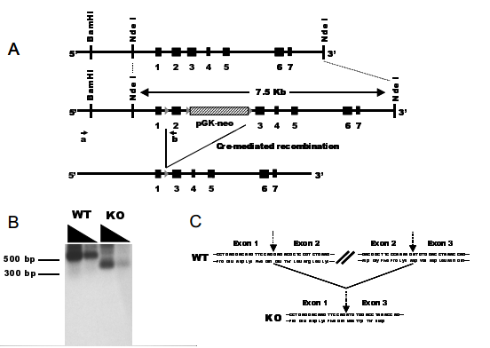
Aire Mutant
Anderson et al,
Notes:
Development
Chromosome 10 (20 haploid, 40 in all) To create this mutant, the originating investigator employed a targeting vector bearing a loxP site-flanked Pgk-neo cassette inserted into intron 2. An additional single loxP site was placed in intron 1. The targeting construct was electroporated into 129S2/SvPas-derived D3 embryonic stem (ES) cells. Correctly targeted ES cells were injected into C57BL/6 blastocysts. The resulting chimeric mice were mated with CMV-cre transgenic mice on a C57BL/6 background. Exon 2 and portions of introns 1 and 3 were excised in the offspring. The resulting chimeric animals were crossed to C57BL/6 mice. Heterozygous offspring were crossed to
We engineered a line of mice carrying a defective aire gene by means of lox/cre-mediated recombination in embryonic stem (ES) cells (fig. S1). These mice carry in homozygous state a mutant allele bearing a deletion of exon 2 and portions of the upstream and downstream introns (fig. S1A). Mature aire gene transcripts could be detected at nearnormal levels in the thymus of mutant mice, but these were smaller than in the wild type, as expected given the absence of exon 2 (fig. S1B). Sequence analysis confirmed that these transcripts could not give rise to functional protein because a frame shift provoked by the abnormal juxtaposition of exons 1 and 3 resulted in premature truncation shortly after exon 1 (fig. S1C). The aire gene mutation was generated in ES cells derived from mice of the Sv/129 strain, and mice used in the experiments described here were from F[sub2] or F[sub3] backcrosses onto the B6 genetic background.
Cre-recombinase-enzyme that recognizes specific lox p sites
Lox P sites-particular DNA sequences
Cre enzyme binds to site, cuts it in half and splices together the halves after target DNA has been removed

Slide 36
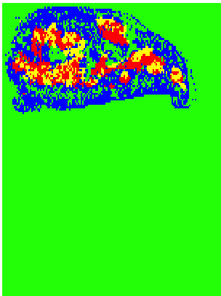
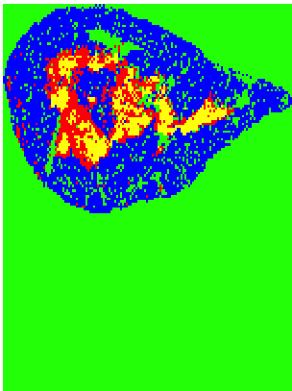
WT WT Mutant Mutant
Notes:
M1 surrounds M2 in WT, adjacent in Mutant; organization of clusters appears to be different; quantify organization difference
Connected component labeling-technique Identify individual cluster components for each cluster; Manually find centroid (center of mass);
measure distance between red and yellow cluster components
WT=centroid in center; small distance between: M2 is inset in M1
Mutant-adjacent, further distance between ; offset from
Still refining method to work with dataset; way of identifying clusters with CCL is imperfect.
Although mutant looks different, we need to increase sample size to make sure this is real; draw conclusions

Slide 37
Virtual Sections
Antibody Set 1
Antibody Set 2
Antibody Set 3
Virtual section
Collapse 3 virtual sections= virtual slice

Slide 38
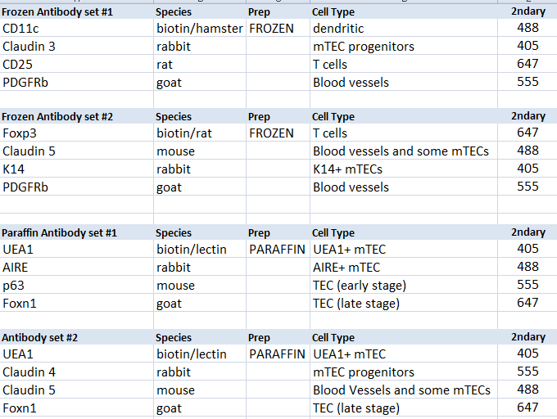
Combinations of Antibodies Finalized List-Frozen and Paraffin 7 cell types
Notes:
Cross reaction if 2 of same species in same set
CD11c-dendritic cells (antigen presenting) and some activated t cells, Central tolerance of T cells, b cells and NK cells (apoptosis of self reactive t cells), cellular adhesion
Claudin3&4- membrane protein, tight junction family, cell to cell adhesion in epithelial/endothelial sheets, for seals around cells, physical barrier to solutes and water, PREFERENTIALLY EXPRESSED IN aire+ mTECS, CLDN3,4, UEA1 tecs represent initial progenitors specified for Aire+ mTECS
CD25-glycoprotein, expressed on activated T and B cells, thymocyte subsets, pre-b cells, and t reg cells, IL2 receptor, transmembran protein present on activated T cells, DN2 and DN3 are CD25+ ; DN1-DN4 – CD4 CD8 SP
PDGFRb-Perivascular cells express mesenchymal markers, so does capsule
Gene encodes a cell surface tyrosine kinase receptor, binding causes phosphorylation (may control growth, division, movement, survival, development)
Foxp3-forkhead box p3, transcriptional regulator, high expression in CD4CD25 reg t cells, suppress immune response of other cells “self check” to prevent excessive reactions and prevent self reactivity, occurs in medulla, some t cells become Treg and rest leave thymus
Claudin5-cell surface/transmembrane marker, claudin family, tight junction strands of endothelia and epithelia tissues
K14-keratin, cytoplasmic intermediate filament protein, expressed in epithelial tissues, provide mechanical support, maintain cell shape
UEA1-lectin (binds carbohydrate), endothelial cell marker, binds K8 and not K14,K5, AIRE more preferentially expressed in this subset, suggests these cells represent more advanced stage of mTEC differentiation
AIRE-autoimmune regulator, transcription factory that is highly expressed in perinuclear region of mature medullary thymic epithelial cells, central tolerance, controls transcription of many genes encoding highly diverse, tissue-restricted self antigens, in absence of AIRE, mTECS fail to delete thymocytes expressing Tcell “self” receptors
P63-related to tumor suppressor gene family, early epithelial cell marker, induces expression of differential markers and shortly after its own levels are reduced, may stimulate cell survival
Foxn1-member of forkhead transcription factor family, generates mature thymic epithelial cells from immature progenitory, requires through development to maturity, “master regulatory” in TEC lineage specification, tec patterning in fetal stage and tec homeostasis in postnatal thymus

Slide 39
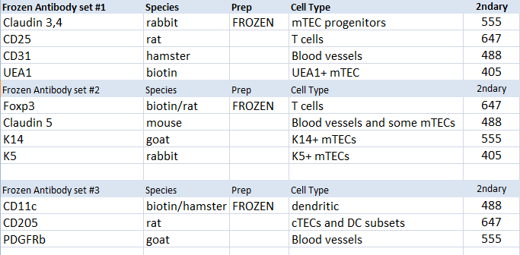
Combinations of Antibodies Finalized List-Frozen 11 cell types

Slide 40
Size conversion (from pixels to mm)
Original pixel size/4 = ~1500 pixels width
6695 pixels =8.5mm
788 pixels/mm
6462 pixels = 8mm
810pixels/mm
5635=7mm
805 pixels/mm
Notes:
CellProfiler uses pixel information, outputs info in pixels
Pixels not biologically meaningful, change to mm (1000 microns) or microns

Slide 41
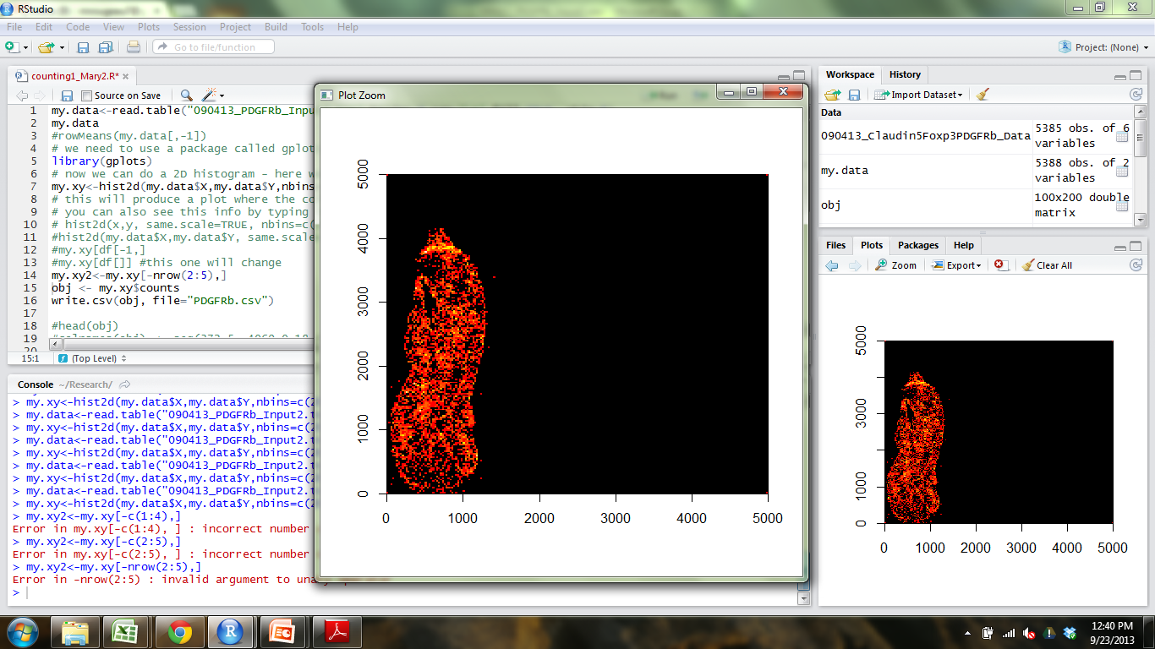
R
Notes:
CellProfiler outputs X and Y coordinates of cells
2dHistogram function to bin coordinates into quadrants of size that I choose-200x200 boxes, 100x100-
want to look like community matrix, with bins that has count info
Since I am looking at multiple sections, I want bin sizes to be the same between sections
I add 4 points (0 and point larger than section height)-6000 for thymus1
(0,0) ,(0,6000),(6000,0),(6000,6000) (I wanted them to be square)
2dhisto-Matrix (grid) is built that holds the counts that fall into each bin/quadrant of grid
Use the counts in the quadrants for analysis

Slide 42
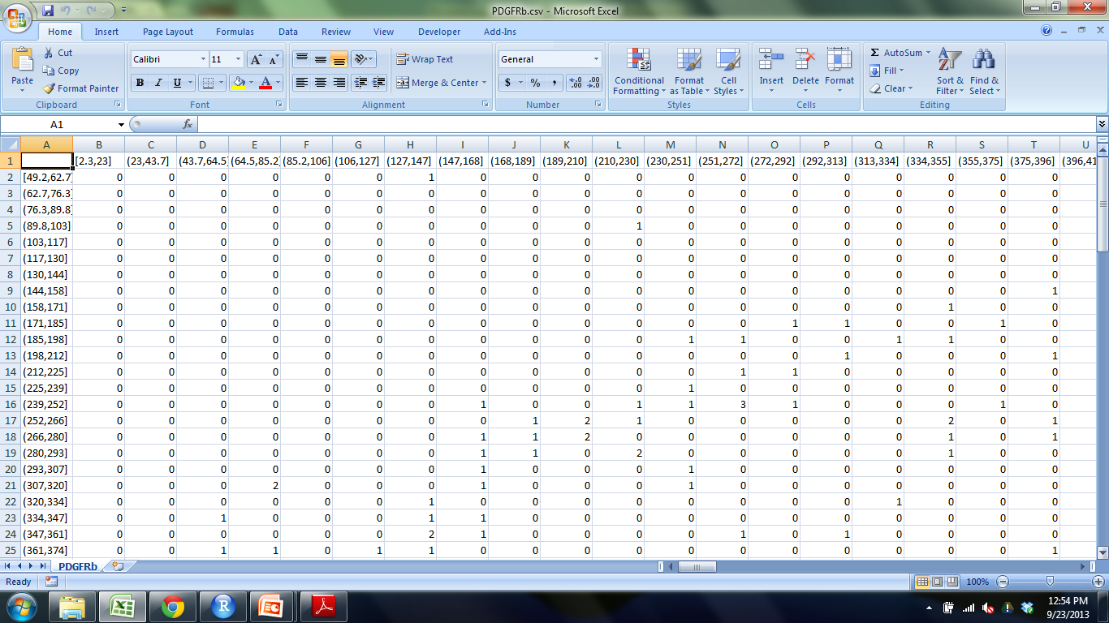
Output from 2D histogram
Notes:
Cell counts in each bin/quadrant
Bin sizes are in pixels, convert to mm or microns

Slide 43
Standard Real Measurement of bin sizes
5635 = 7 mm
5635/7 = 6000/x x=height of 6000x6000 box in mm
X= 7.453 mm
Assuming 200x200 bins
7.453/200 = 0.037265mm = 37.2 x 37.2 microns

Slide 44
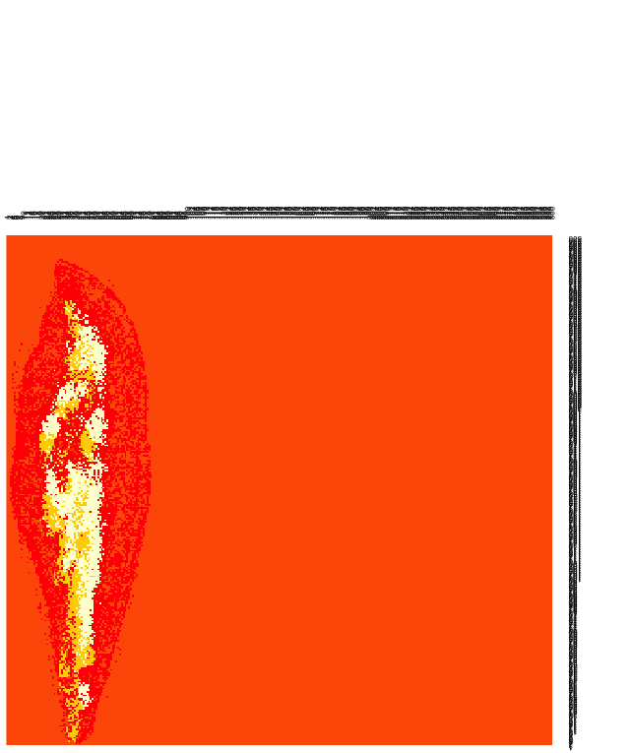
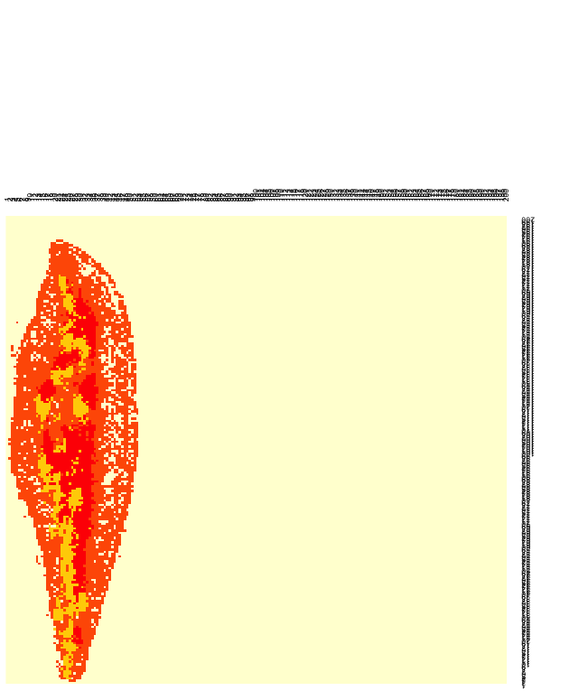





Different bin sizes (K=4)
400x400 350x350 300x300 250x250 200x200 150x150 100x100
Which bin size is optimal?
Notes:
First time I did analysis, I Randomly picked 200x200, cell counts in each bin were reasonable number (not too high or low)
Not good reason, Need something to support this number

Slide 45


Rarefaction Curve
Area (mm2) | BINS
0.00022 | 500x500
0.00027 | 450x450
0.00035 | 400x400
0.00045 | 350x350
0.00062 | 300x300
0.00089 | 250x250
0.00139 | 200x200
0.00247 | 150x150
0.00555 | 100x100
0.0222 | 50x50
Notes:
Determining the optimal quadrant size: Rarefaction
Rarefaction-technique used in ecology to assess species richness (# of species) from the results of sampling.
The issue that occurs when sampling species in a community is that the larger the number of samples, the more species that will be found.
When have you collected enough samples? (when is the bin size small/large enough) large bin size=more samples, get to point where you will lose info
Want to find the smallest unit of area that still contains useful information, construction of rarefaction curves,
Selected 5x5 quadrants and took average over a section of thymus that contained #of cell types (as opposed to # of cells). I did this 8 times in cortex and 8 times in medulla (since medulla had higher cell counts than cortex) and took average of that
Steep slope indicates that a large fraction of the species diversity (cell types) remains to be discovered.
When the curve becomes flatter to the right, a reasonable number of individual samples have been taken: more sampling is likely to yield only few additional species.
Saturated for medullary region when curve plateaus, probably won’t have all 7 cell types in the cortex (medullary markers)

Slide 46

Community Matrix
Notes:
Take the count information from 2Dhistogram and Reformat into community matrix with some species (columns) and where they are located (rows).
Initially had location information (way of identifying bin locations) but this info took over the clustering
This is the format I will use for my analysis (kmeans)

Slide 47

CellProfiler Results-Blood vessel marker
CD25
Notes:
Input images from Ptgui into Cellprofiler to get cell counts which will be used for analysis
Real signal, Intensity of fluorescence
Different colors = different cells,
Finds centroid of cell and outputs x and y location
This shows a zoomed in portion of the thymus so you can see what CP considers to be a cell
Green is what CP detects bc of parameters I set, centroid!
Take cellprofiler results, reformat, use them in R
Place grid over thymus section and record # of cell for each cell type that fall into each box of the grid

Slide 48


How is clustering being done?
Red Yellow
Blue Green
CD11c CD205 CD31 Claud34 Foxp3 K14 K5 PDGFRb UEA1
Notes:
Is it consistent bt samples?
Produced graphs showing the amount of cell type per cluster.
Look at how cell types are clustering and what cell types could be driving this clustering

Slide 49


Number of Cells
Number of Cells
Cell markers
Cell markers
Cell markers
Number of Cells
Number of Cells
Cell markers
Cell markers
Number of Cells
Number of Cells
Cell markers
Cell markers
Number of Cells
Number of Cells
Cell markers
Cell markers

Slide 50
Bray Curtis
OUTER CORTEX MEDULLA1 MEDULLA2
WT1S2 O
WT2S2 O
WT2S1 M1
WT2S3 C
WT2S2 M1
WT1S1 C
WT2S3 M1
WT2S2 C
WT1S2 C
WT1S2 M1
WT2S3 M2
WT1S1 O
WT1S3 O
WT2S3 O
WT1S3 M2
WT2S1 O
WT1S1 M1
WT1S3 M1
WT2S1 M2
WT1S3 C
WT2S1 C
WT1S1 M2
WT1S2 M2
M2S3 M2
WT2S2 M2
Notes:
Produced dendrogram using BC results
There is small variability between sections (don’t expect them to be identical)
Regions are grouping together, aren’t just grouping with sample they came from
Based on these results, different samples are compositionally similar.

Slide 51
Bray Curtis Dendrogram
OUTER CORTEX MEDULLA1 MEDULLA2
Key
WT1=
WT2=
WT1S2 O
WT2S2 O
WT2S1 M1
WT2S3 C
WT2S2 M1
WT1S1 C
WT2S3 M1
WT2S2 C
WT1S2 C
WT1S2 M1
WT2S3 M2
WT1S1 O
WT1S3 O
WT2S3 O
WT1S3 M2
WT2S1 O
WT1S1 M1
WT1S3 M1
WT2S1 M2
WT1S3 C
WT2S1 C
WT1S1 M2
WT1S2 M2
M2S3 M2
WT2S2 M2
Notes:
Produced dendrogram using BC results
There is small variability between sections (don’t expect them to be identical)
Regions are grouping together, aren’t just grouping with sample they came from
Some of One sample are grouping more closely with M2 than M1, NEED LARGER SAMPLE SIZE
Based on these results, different samples are compositionally similar.

Slide 52

NORMALIZED
OUTER MEDULLA SUBCAPSULE CORTEX
M2S1 O
WT2S1 O
WT1S1 O
M1S3 O
WT1S3 O
M1S2 S
M1S2 O
M1S2 M
WT2S3 S
M1S1 C
M2S2 O
M1S3 C
M1S1 O
WT2S2 O
WT2S3 O
WT1S2 O
WT2S1 M
M2S3 O
WT2S1 C
M2S1 C
M2S3 M
M2S2 M
M1S1 S
WT1S3 C
M2S2 C
WT2S3 M
WT1S3 S
M2S3 S
WT1S1 S
WT2S2 M
WT1S1 M
WT1S2 M
M1S3 S
WT1S1 C
WT2S2 C
M2S1 M
M1S3 M
WT1S2 S
M2S1 S
M2S2 S
WT1S3 M
M1S1 M
WT2S2 S
WT2S1 S
WT2S3 C
WT1S2 C
M2S3 C
M1S2 C

Slide 53
Bray Curtis Dissimilarity Index
OUTER CORTEX MEDULLA1 MEDULLA2
Key
WT1= Mutant1=
WT2= Mutant2=
M1S2 C
M2S3 O
M2S3 C
WT2S1 M1
M1S2 M2
M1S1 O
M2S1 C
WT2S2 M1
M1S3 M1
M1S2 O
M1S3 O
M1S2 M1
M1S1 M1
WT1S2 O
M1S1C
WT2S3 C
WT2S2 O
M1S3 C
WT1S1 C
M2S2 O
WT2S2 C
M2S2 C
WT2S3 M1
M2S1 O
WT1S1 O
WT1S3 O
WT2S3 O
WT1S2 C
WT2S1 O
M2S1 M1
WT1S2 M1
WT1S2 M2
M2S1 M2
M2S3 M1
WT1S1 M1
M2S2 M1
WT2S1 M2
WT1S3 M2
M2S2 M2
WT2S1 C
WT1S3 M1
M1S3 M2
WT2S3 M2
M2S3 M2
WT1S3 C
WT1S1 M2
M1S1 M2
WT2S2 M2
Notes:
Produced dendrogram.
Based on these results, different samples are compositionally similar. What about spatially?

Slide 54

Connected Component Labeling-Mutant1
Notes:
Look at spatial distribution of clusters as opposed to composition
Looks at components that are connected; find centroid, compare to centroid in other cluster

Slide 55

Connected Component Labeling-WT1

Slide 56




Slide 57





Slide 58
CCL results
CCL Average
WT Mutant
3.95 5.84
Manual
WT Mutant
1-2 5.84
Notes:
RESULTS of ccl for wildtype
way of identifying clusters with CCL is imperfect bc of shape of clusters
Still refining method to work with dataset;
Although mutant looks different, we need to increase sample size to make sure this is real; draw conclusions

Slide 59
CCL
 | Mean | Variance
WT1_150 S1 | 3.95 | 4.61
S2 | 4.03 | 3.52
S3 | 3.35 | 2.05
WT2_150 S1 | 7.84 | 21.52
S2 | 4.69 | 5.60
S3 | 9.67 | 48.74
Mutant1_150 S1 | 5.84 | 3.73
S3 | 3.46 | 1.35
Mutant2_150 S1 | 11.71 | 60.7
S2 | 11.67 | 58
S3 | 9.014 | 50.84

